Slide 1
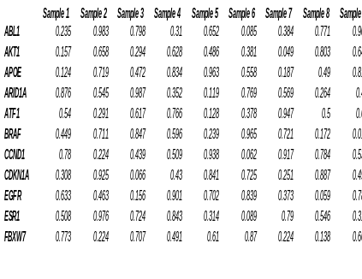
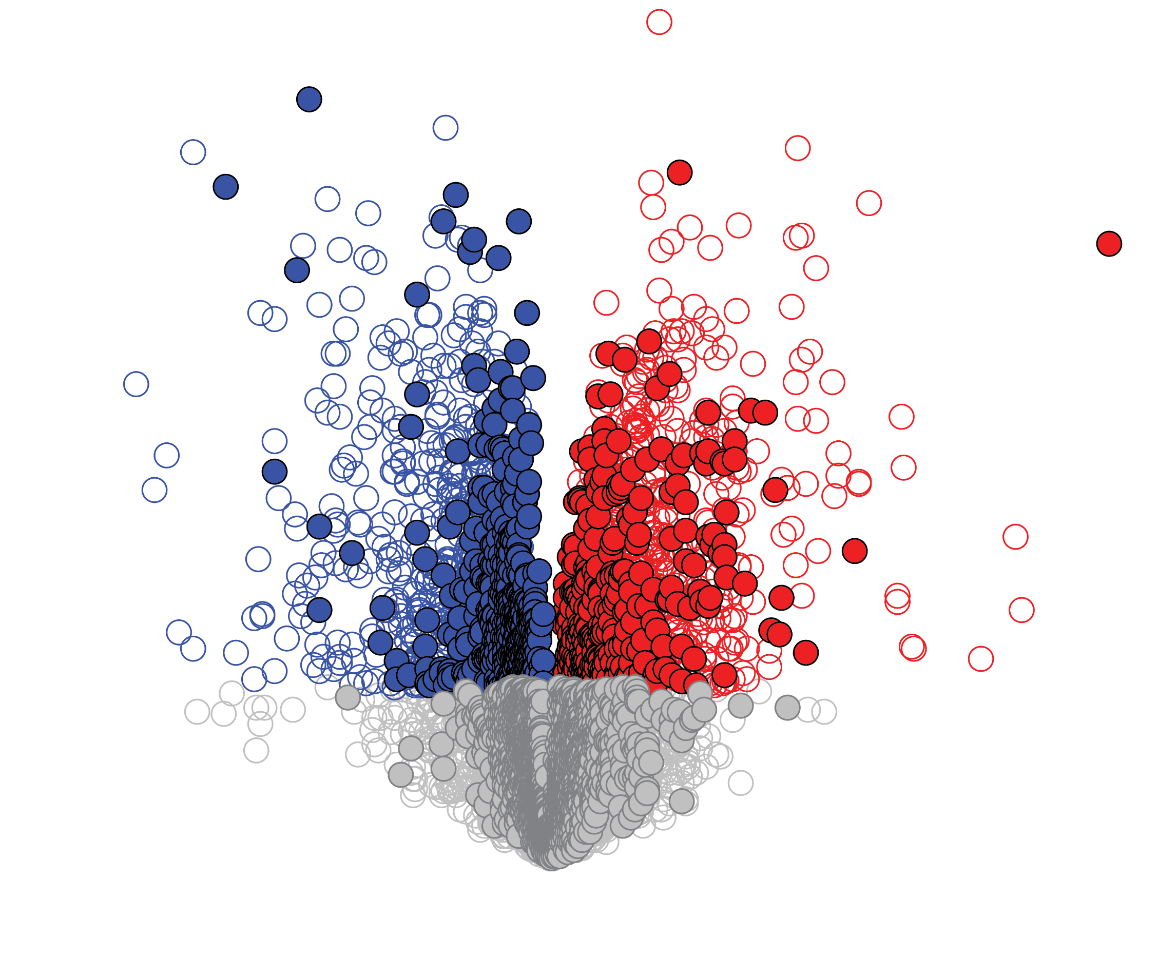
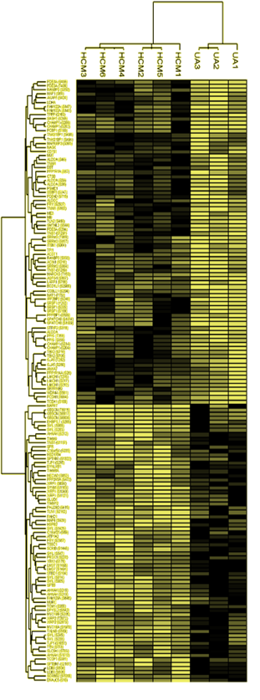
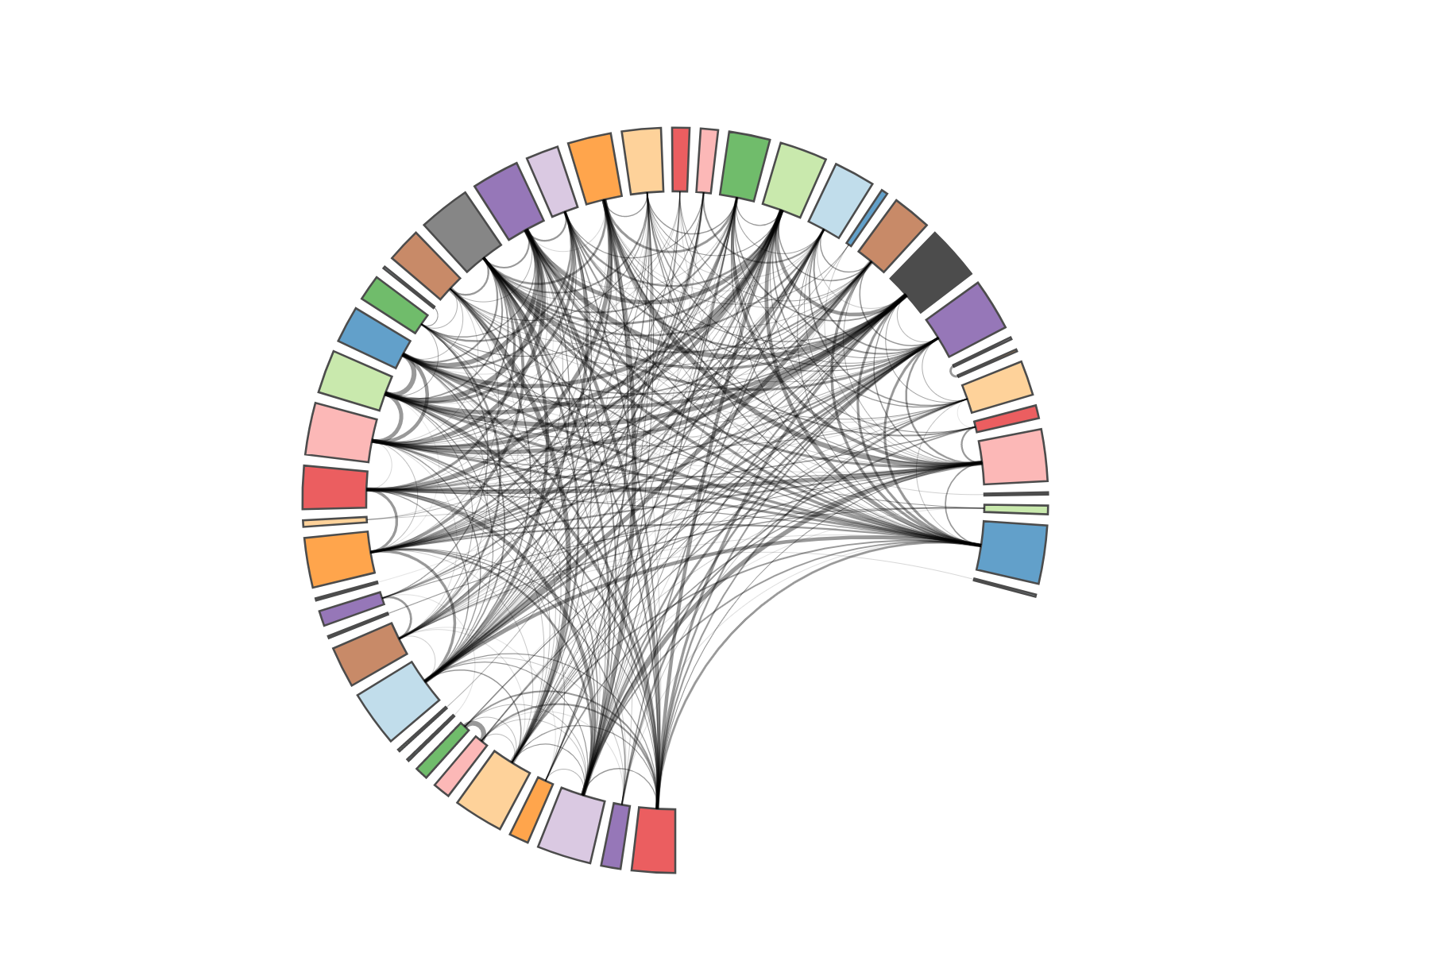
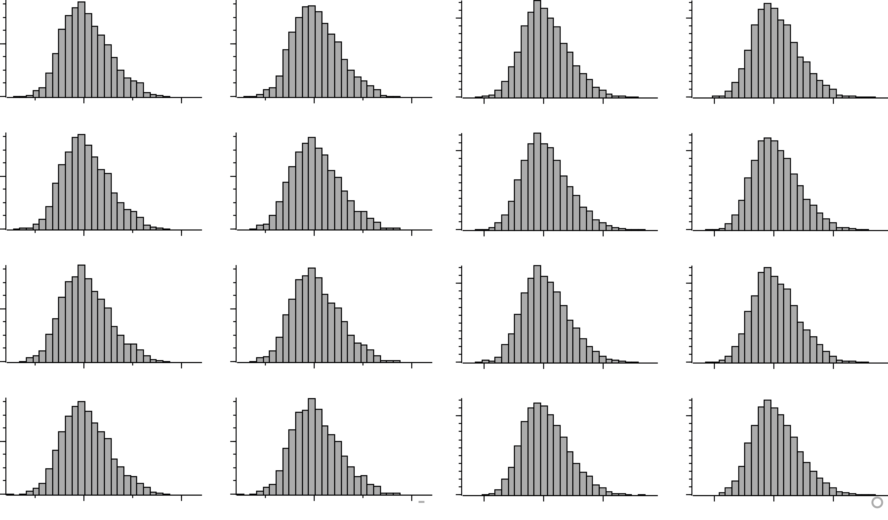
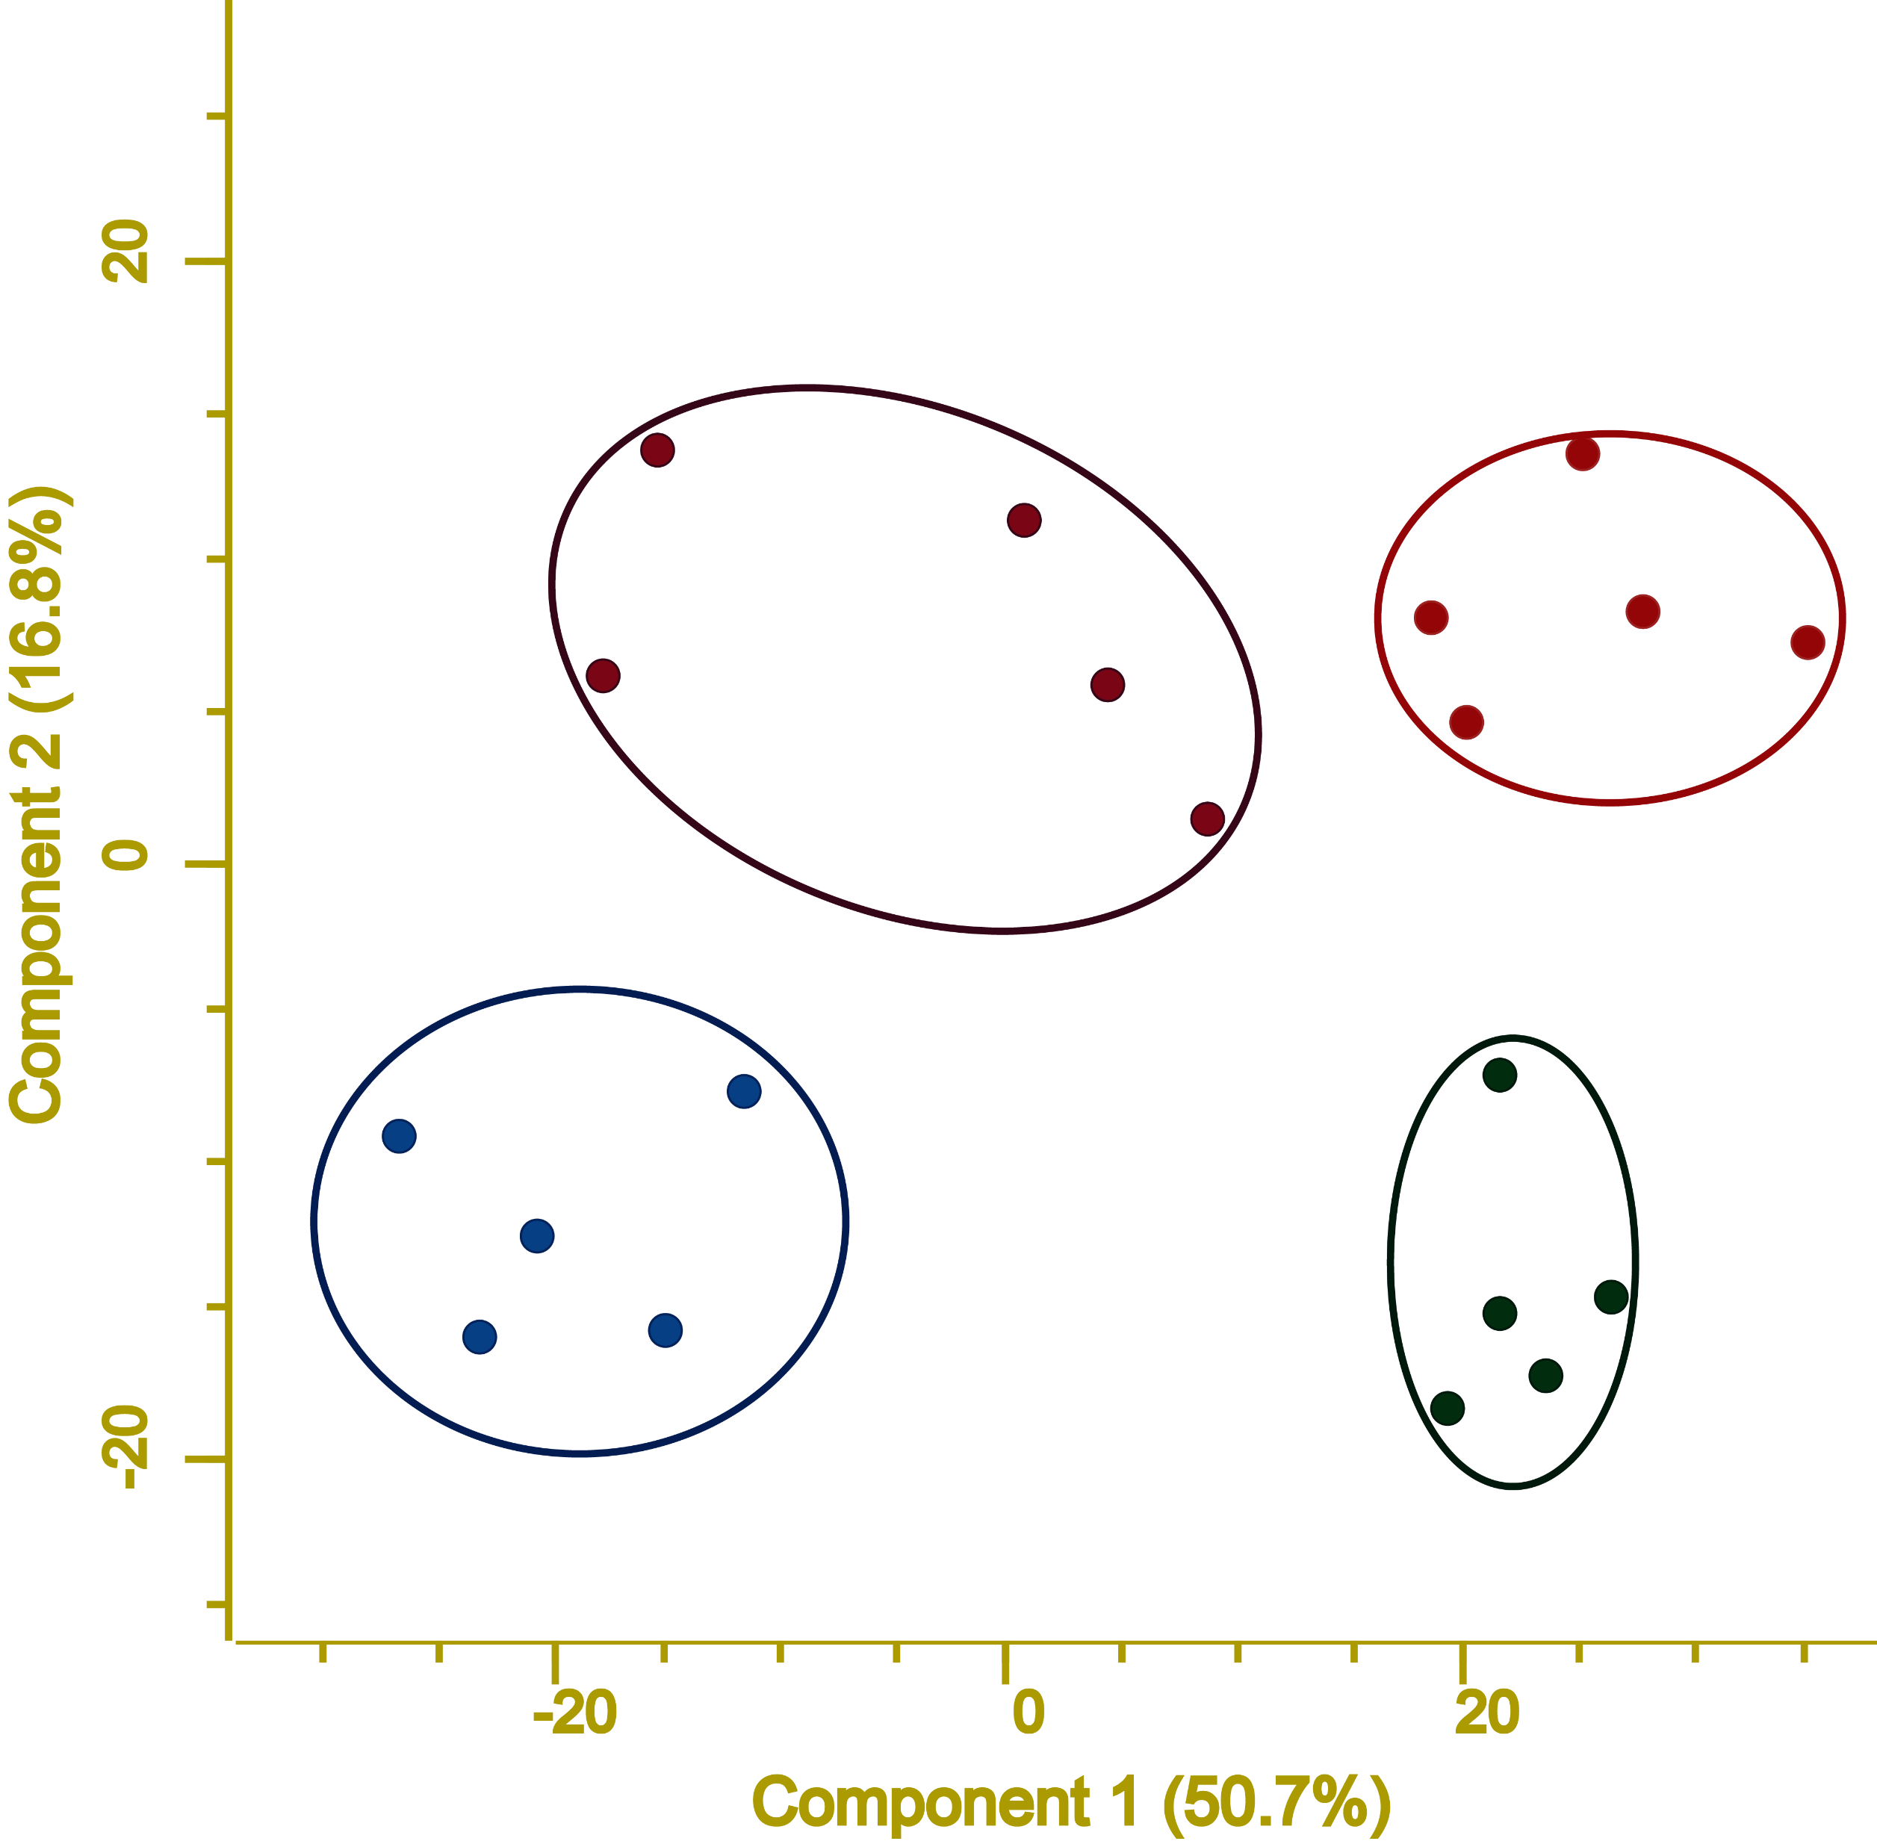
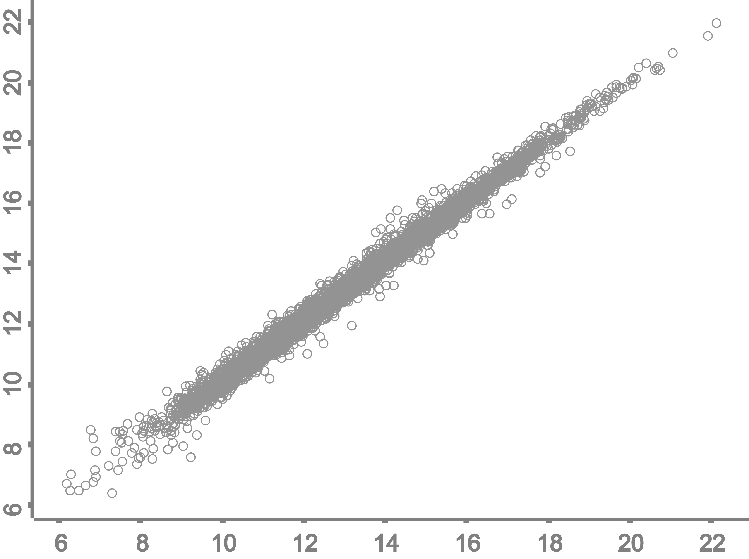
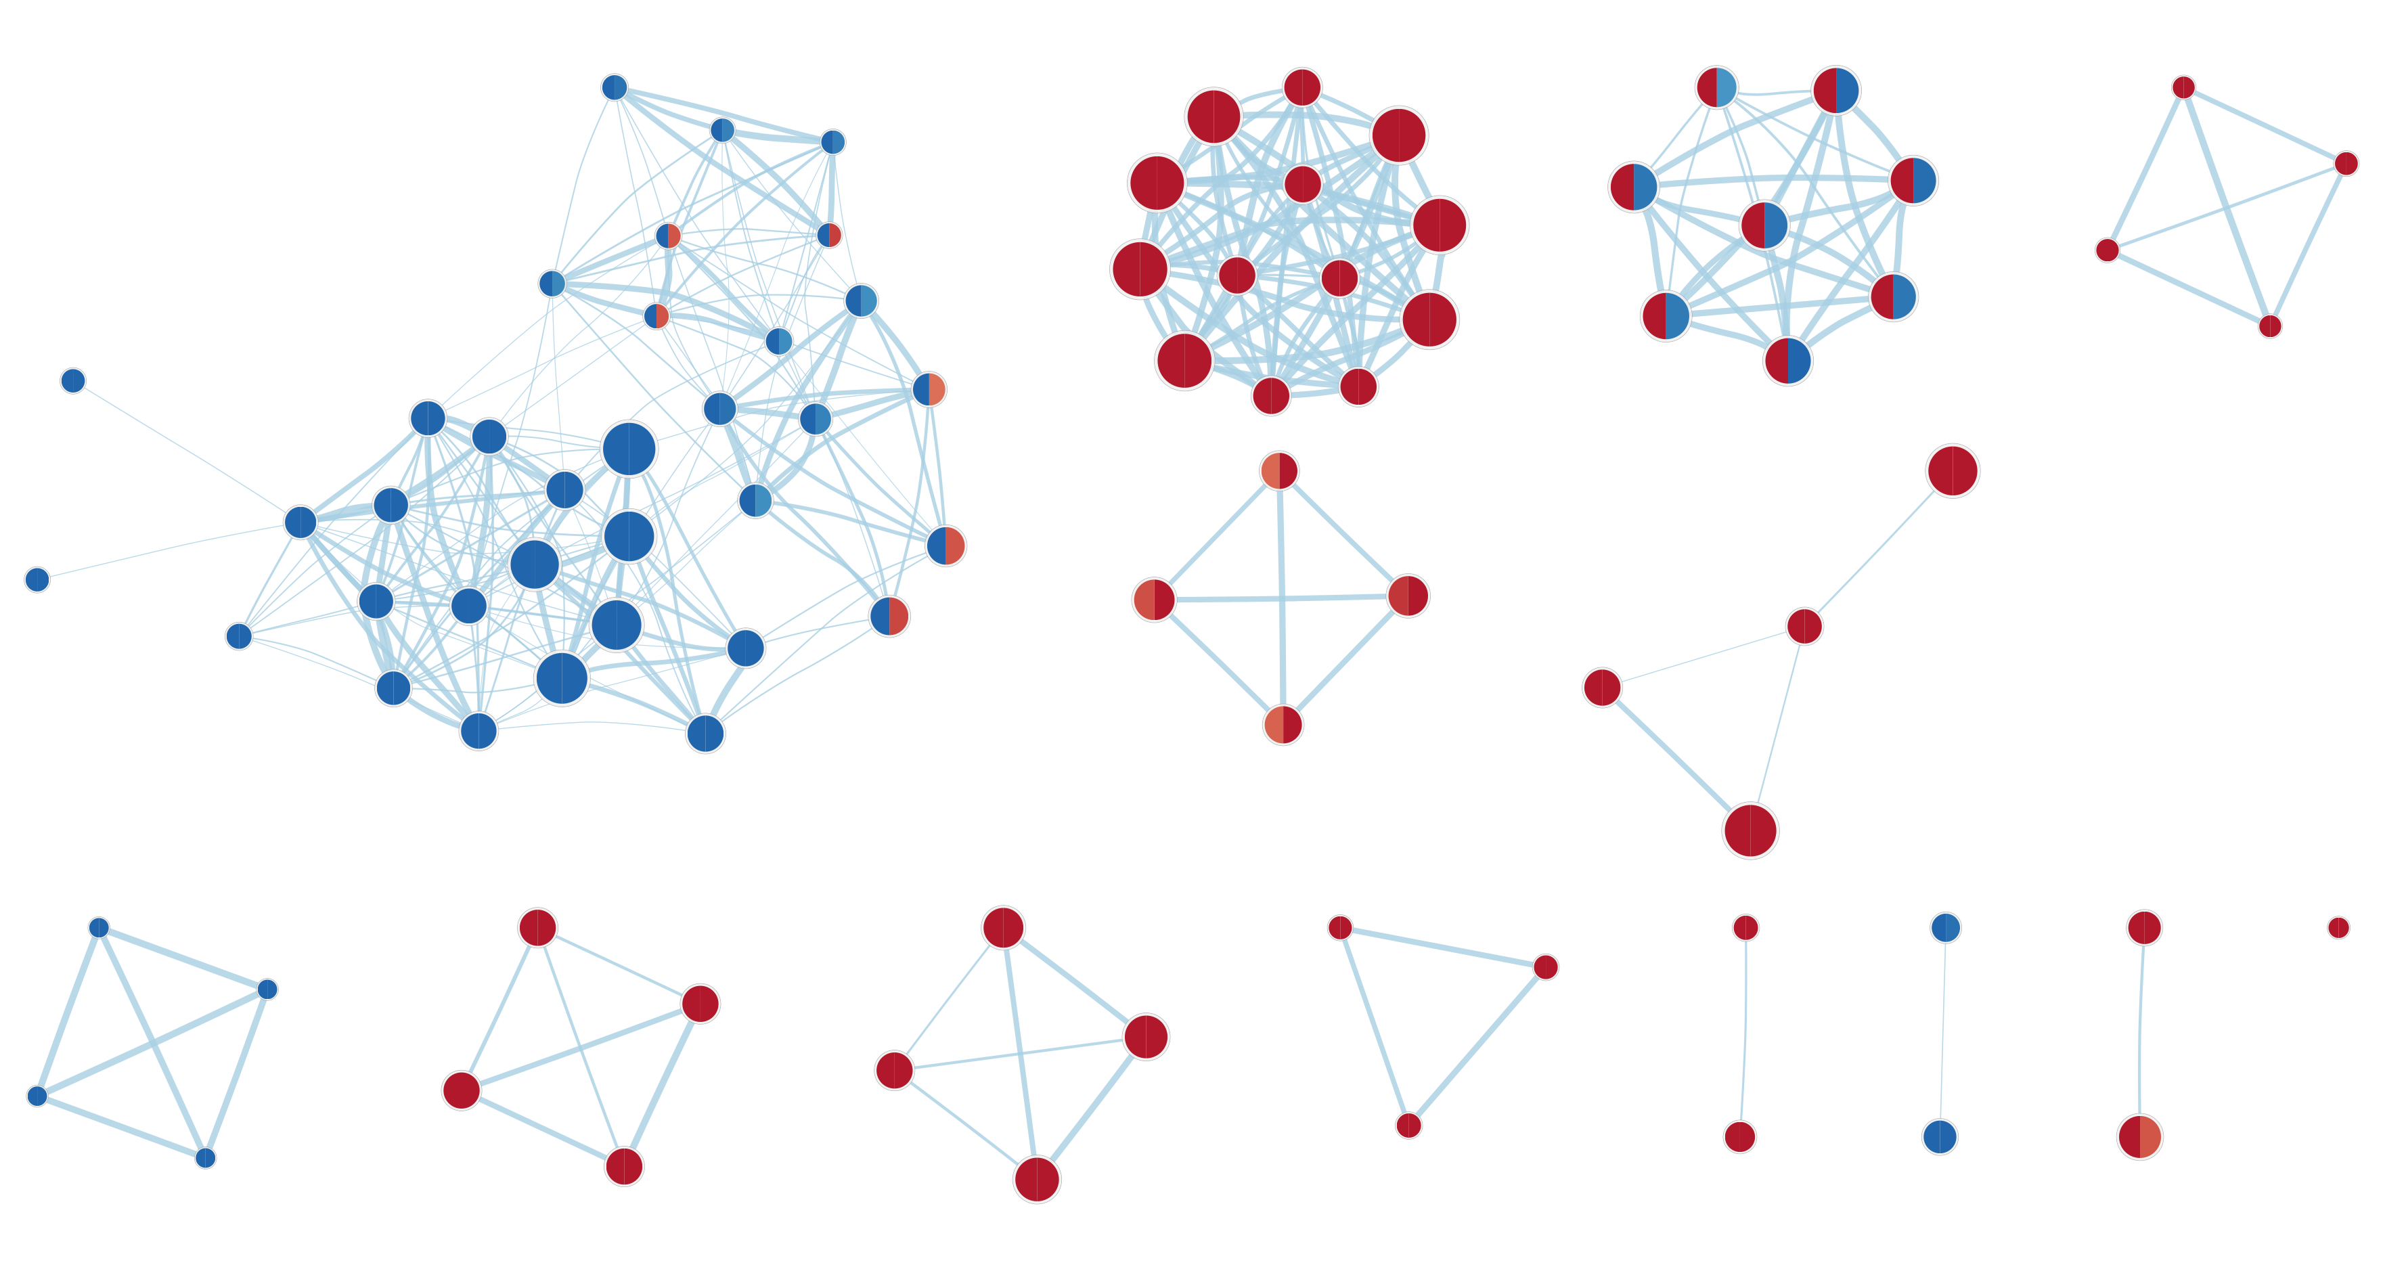
ORGANIZATION AND
QUALITY CONTROL
PAIRWISE ANALYSIS
MULTIDIMENSIONAL ANALYSIS
NETWORK BIOLOGY AND INTEGRATION

Slide 2
Initial Consultation
Experimental Project Plan
Sample Preparation
Data Generation
Data Analysis
Pre-Publication Services

